Slide 1

Client Acquisition Strategy
LaKi Solutions

Slide 2























Agenda
Segmentation
Targeting
Available Tools
Positioning
Recommendation
Client Acquisition Strategy
Automation Process
Review, Test & Adapt

Slide 3


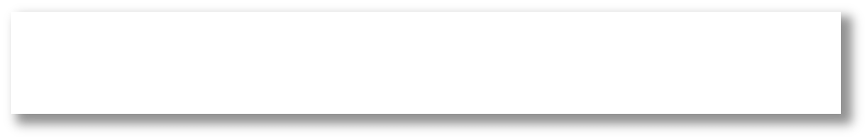



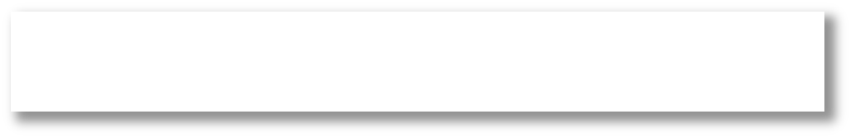





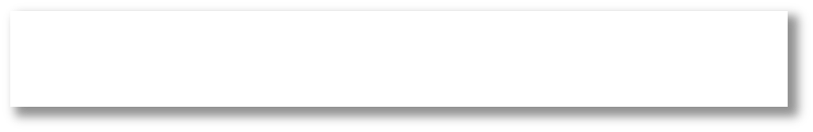


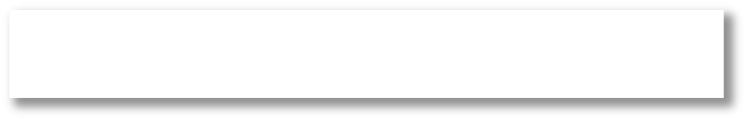





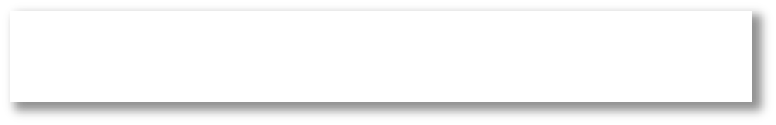




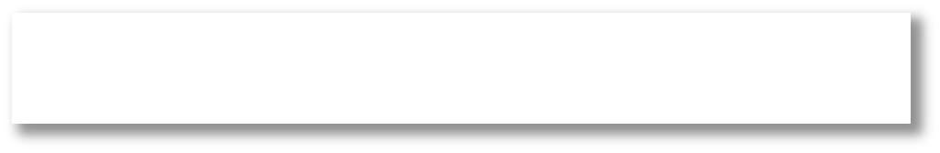



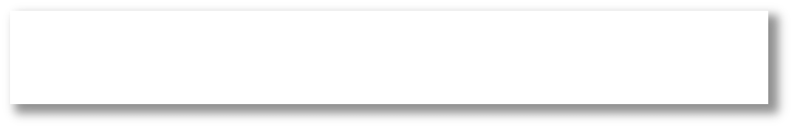




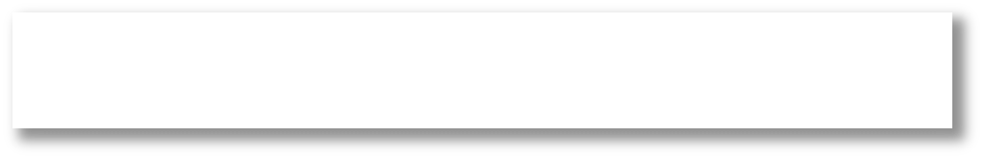








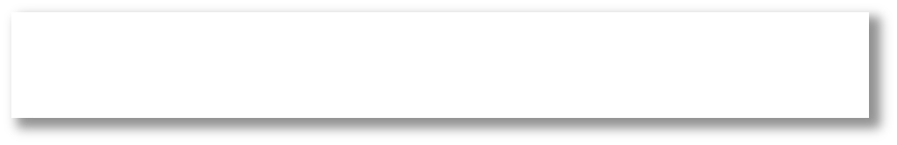





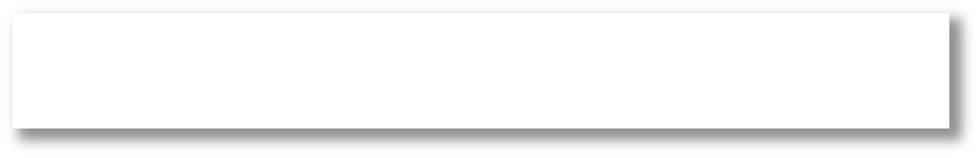




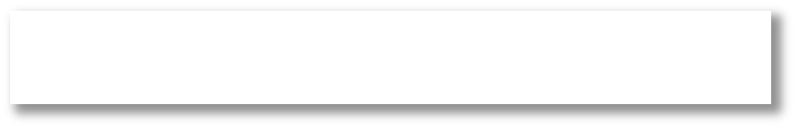


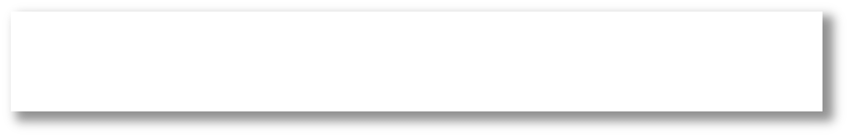
Segmentation – Enterprise & SMEs
Production Line Automation
QSR
Fast Food
Supply Chains
Checkout Automation
Segment 1
SaaS Companies
Software
Bespoke AI-tools
AI-Driven Analytics
Industry
Warehouse
Manufacturing
Logistics Optimization
Construction
Segment 2
Inventory / Logistics Costs
Retail
Reduce Logistics Costs
Chatbots

Slide 4

Laki Solutions Market Opportunity
Key Insights and Future Outlook Worldwide Digital Transformation Spending ($ T n)
AI adoption among organizations increased from 20% in 2017 to 72% in 2024
The UK AI market is worth more than £16.6 billion, according to the US International Trade Administration, and is expected to grow to $788.4 billion by 2035.
The AI chatbot market is projected to reach a significant size of $454.8 Millions by 2027, growing at a CAGR of 24.5%.
The number of UK AI companies has increased by over 600% over the last 10 years
68% of large companies, 33% of medium-sized companies, and 15% of small companies have incorporated at least one AI technology
CASE: Following a 10-week trial of computer vision technology, Marks & Spencer reported an 80% reduction in warehouse accidents
Chatbot Market Revenue Growth Forecast ($M)
* Client Needs
(Yahoo Finance, 2024)
Market Key Statistics
Importance
Pricing
$600
$500
$400 $300 $200
$100
Compatibility
Cost Savings
Transparency
Flexibility
Privacy & Security
+ 2 4 . 5 %
$4 . 5Tn
Market
24.5%
CAGR
6 0 0 %
Increase of AI Adoption in UK
2022
2023
2024
2025
2026
2027
(Master of Code, 2024)
* (Gartner, 2024)

Slide 5
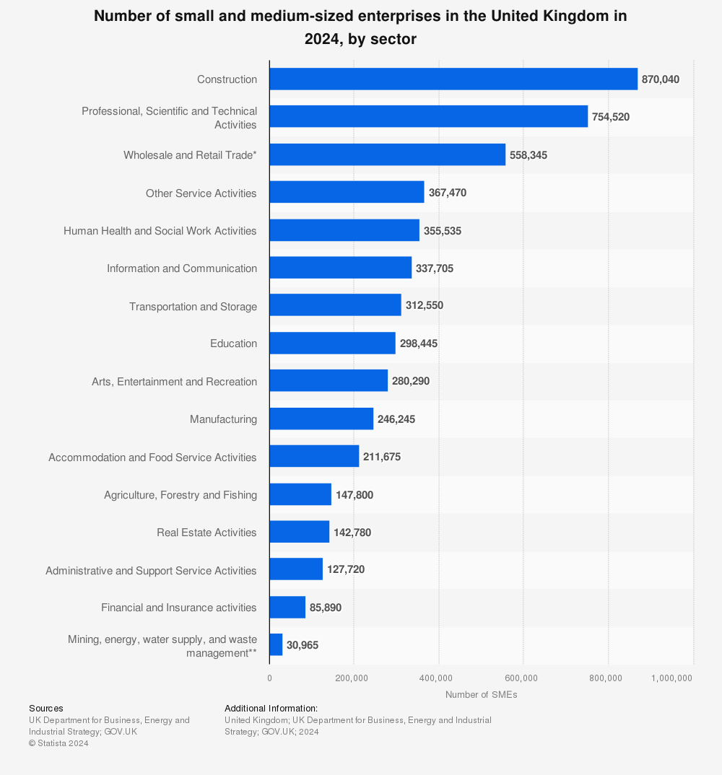
Laki Solutions Market Opportunity – Cont.
Construction Sector Leads SMEs – The construction industry has the highest number of small and medium-sized enterprises (SMEs) in the UK
•Wholesale and Retail Trade -558,345 SMEs
•Human Health and Social Work Activities - 355,535 SMEs
•Transportation and Storage - 312,550 SMEs
•Accommodation and Food Service Activities - 211,675 SMEs

Slide 6
Potential impact of generative artificial intelligence (AI) on industry revenues worldwide in 2023, by industry (in billion U.S. dollars)
High-Tech Leads AI Revenue Impact – The high-tech industry is expected to see the greatest revenue increase, reaching nearly $460 billion in added revenue due to generative AI.
Broad Industry Adoption – Retail, banking, transport, manufacturing, and consumer goods are among the top sectors experiencing significant AI-driven revenue growth, highlighting AI’s widespread influence.

Slide 7

Size of the natural language processing (NLP) market worldwide from 2020 to 2030 (in billion U.S. dollars)
Market size of NLP globally from 2020-2030
The global NLP market is projected to grow from $13.38B in 2020 to $156.76B by 2030
Rapid adoption is expected after 2025, driven by AI advancements and business integration.
Key growth drivers - include chatbots, sentiment analysis, and AI-powered automation across industries.
Billion U.S. dollars

Slide 8
HOW WE ARE GOING TO TARGET
Now that we have identified our target markets, the next step is to discuss how we will effectively reach and engage them. Let’s explore the best the tools available for lead generation, and the top CRM solutions that can help us streamline our approach and maximize customer engagement.

Slide 9
CRM Tools Comparation
Tool | Best For | Marketing Automation | Sales Automation | Ease of Use | Pricing
HubSpot | Best all-in-one CRM & marketing automation | Email marketing, automation, landing pages | sales sequences, pipeline tracking | User-friendly | Free plan + Paid
Salesforce | Best for large enterprises & advanced CRM | Powerful but complex | AI-driven sales automation | Steep learning curve | Expensive
Zoho CRM | Best for affordability & small businesses | Email automation, AI-driven insights | good pipeline tracking | Easy to use | Paid
Pipedrive | Best for sales-focus ed teams | Limited marketing tools | Great for deal tracking & automation | Very easy | Paid
Freshsales (Freshworks CRM) | Best for AI-powered sales insights | Automation & email campaigns | phone & chat integrations | User-friendly | Paid
ActiveCampaign | Best for marketing automation | Best-in-class email automation | Sales tools not as strong | More marketing- Focused | Paid

Slide 10
Client Leads Tools Comparation
Tool | Best For | Database Size & Accuracy | Key Features | Integrations | Compliance
Apollo.io | Balanced prospecting & outreach | 250M+ contacts, 65%+ accuracy | Email & phone enrichment, outreach automation, AI-driven recommendations | CRM (Salesforce, HubSpot), LinkedIn, Outreach.io | GDPR-compliant
ZoomInfo | Large enterprises & sales teams | 150M+ contacts, highest accuracy | Intent data, AI-driven lead scoring, deep company insights | Salesforce, HubSpot, Marketo | GDPR & CCPA compliant
Lusha | Startups & SMBs needing affordability | 100M+ contacts, 70% accuracy | Chrome extension, real-time contact data enrichment | LinkedIn, Salesforce, HubSpot | GDPR & CCPA compliant
Cognism | GDPR-compliant EU-focused data | 20M+ contacts, 80%+ accuracy | Intent data, sales triggers, AI-driven segmentation | Salesforce, Outreach.io, LinkedIn | Best for GDPR Compliance
Lead411 | Real-time sales triggers & funding alerts | 75M+ contacts, 70% accuracy | Sales trigger alerts, human-verified data, company insights | CRM, LinkedIn, Outreach.io | GDPR & CCPA compliant
UpLead | Data accuracy & Pay as you go pricing | 85M+ contacts, 95%+ accuracy | Real-time email verification, advanced filtering | HubSpot, Salesforce, LinkedIn | GDPR & CCPA compliant

Slide 11
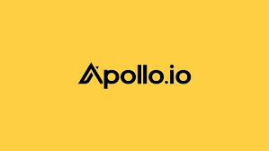
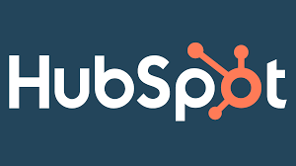
Recommendations
Apollo.io – The Best Lead Generation Tool
1.Largest Database – Over 250M+ contacts with 85%+ accuracy, surpassing competitors in volume and reach.
2.Affordability & Automation – Offers AI-driven recommendations, outreach automation, and cost-effective pricing.
3.Robust Integrations – Seamlessly connects with major CRMs (Salesforce, HubSpot) and LinkedIn for enhanced prospecting.
HubSpot – The Best CRM Tool
All-in-One Solution – Combines CRM, sales, and marketing automation in a single platform.
Ease of Use – User-friendly interface with powerful features like pipeline tracking and email automation.
Flexible & Scalable Pricing – Free plan available with paid options to scale as business grows.

Slide 12
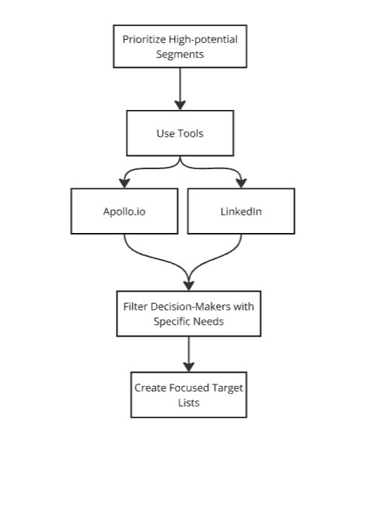
TARGETING
We prioritized high-potential market segments by leveraging Apollo.io, LinkedIn for lead generation, HubSpot CRM to manage and track prospects.This enabled us to filter decision-makers with specific needs and create highly targeted, focused lists for outreach, ensuring a more personalized and effective approach.

Slide 13
























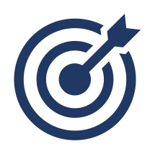
Laki Solutions Client Acquisition Blueprint
2027 TARGET
TARGET GROWTH
Pillars
KEY INITIATIVES
*
Maximize Online & Offline Presence
Leverage SEO & Content Marketing (case studies, blogs on Ai-Driven business solutions)
Increase presence in LinkedIn & X (SME in Trends topics)
Visible
25% Revenue
15% Revenue
Case Studies (E.g. McDonald’s – AI-driven solution)
Obtain client testimonials & reviews
Host Webinars and talks on AI implementation for business
Apply for industry awards & recognitions
*
10% Revenue
Credible
15% Revenue
Implement AI-powered chatbots on website for engagement
Host free AI consultation calls for qualified leads
Offer personalized automation demos
Develop a lead email sequence
Interactive
*
5% Revenue
5% Revenue
*
User Growth: Social Media, Website Newsletter
Engagement; Webinars, blogs. Chatbot responses
Financial; revenue growth, funding secured
Early Metrics
20% Net Profit Growth
20% CARG
*
15% CARG
Optimise Conversion & Repeat Clients
Measure Impact, Case Study Outcomes, and Client ROI
Scale % of customer retention rate & upsell success
Mid Metrics
30% Net Profit Growth
* Average Start-Up budgets (Gartner, 2024)
8

Slide 14
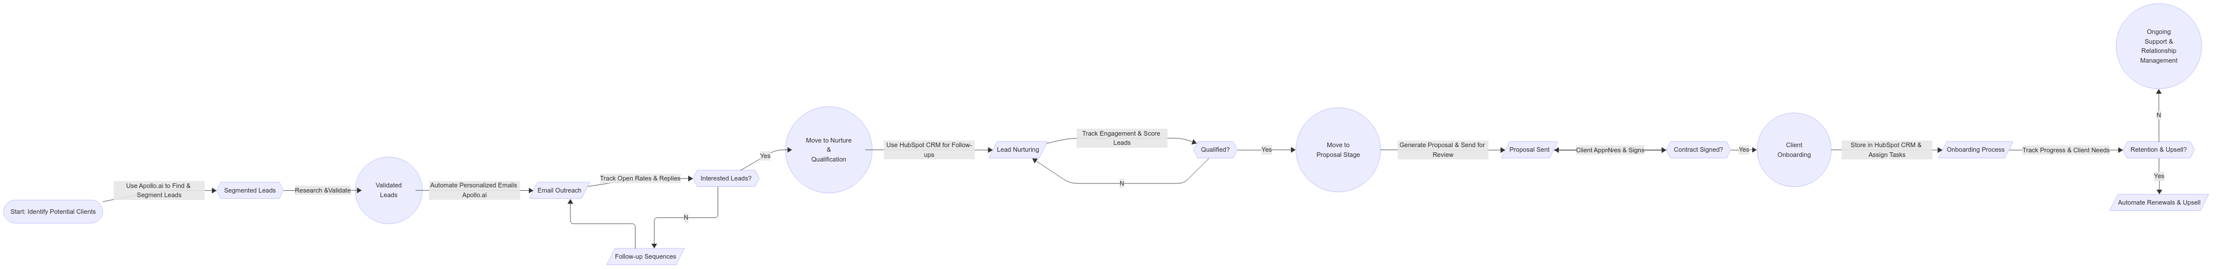

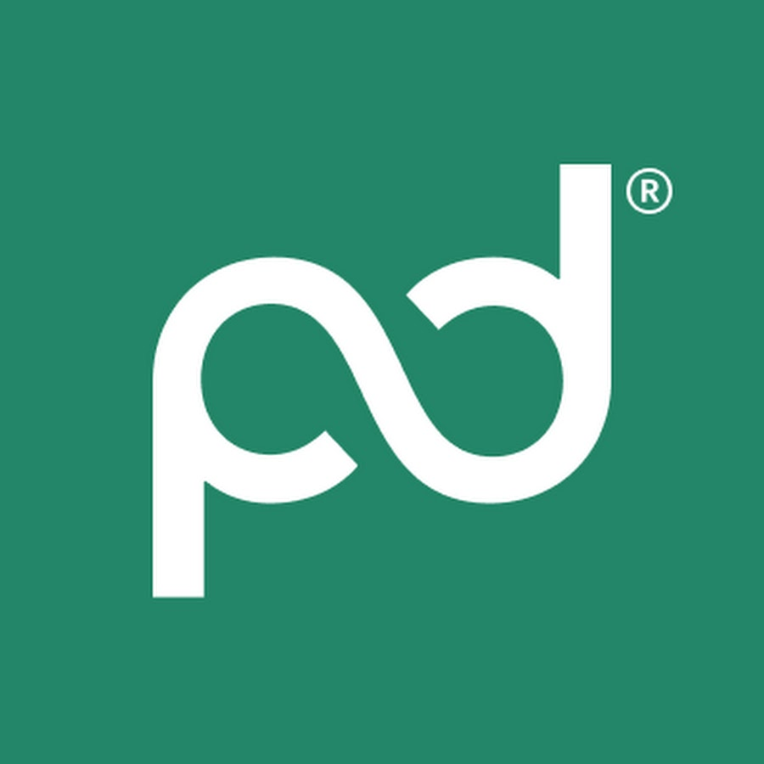
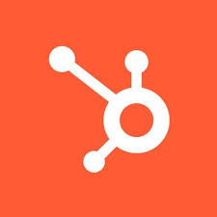
Client Acquisition - Automation Strategy
Notes:
Identify & Find Potential Clients
Use Apollo.ai to advanced search and filtering features to find potential clients based on key criteria (industry, company size, role, location).
Segment potential leads into relevant lists for targeted outreach.
Conduct research to ensure the leads align with your ideal customer profile.
Initial Reach & Engagement
Automate personalized email outreach to the identified leads using Apollo.ai
Send a series of tailored emails to engage prospects and introduce your offerings.
Track email open rates, responses, and interactions to measure the effectiveness of your outreach.
Nurture & Qualify Leads
Use HubSpot CRM to nurture leads by automating follow-up emails and reminders.
Qualify the leads based on their level of engagement, interest, and fit with your service offering.
Set up automated workflows in HubSpot CRM to deliver relevant content or schedule additional touchpoints.
Lead Capture & Relationship Management
Once a lead shows interest (e.g., replies to an email), capture the lead information in HubSpot CRM .
Track interactions, store contact details, and record any communication history.
Assign tasks or follow-up reminders for further engagement.
Use HubSpot CRM to segment leads and track their progress through the sales pipeline.
Proposal & Offer Creation
Once a lead is qualified, move forward with a proposal.
Create a tailored proposal that includes the services or products they’re interested in.
create customized proposals with pricing, terms, and deliverables, ensuring that the offer is compelling and aligned with the client’s needs.
Contract Finalization & Client Onboarding
Send the proposal to the client, enabling electronic signatures for quick contract signing.
Once the proposal is accepted, finalize the contract through keeping everything digitally organized.
Track the status of the proposal and ensure a smooth transition to the onboarding phase.
Ongoing Client Management & Retention
After the contract is signed, continue managing the client relationship via HubSpot CRM .
Track post-sale communication, ensure satisfaction, and provide support when necessary.
Use HubSpot CRM to manage ongoing projects, renewals, or upsell opportunities.

Slide 15
Laki Solution Targets for Client Acquisition
1
Cold Email Outreach
Weekly Target per Person: Send a consistent number of cold emails to target industries
Total Weekly Target for Team: Maintain an overall steady outreach effort.
LinkedIn Connection
Weekly Target per Person: Send a steady number of LinkedIn connection requests
Total Weekly Target for Team: Maintain a consistent outreach effort through LinkedIn
2
Weekly Target per Person: Send a fixed number of follow-up emails.
Total Weekly Target for Team: Maintain a consistent follow-up effort.
Follow-Up Emails
3

Slide 16
Conversion Metrics
4
Response Rate: Cold email campaigns generally see a low but steady response rate.
Meeting Conversion: A portion of email responses typically results in scheduled meetings.
Proposal Conversion: Some meetings may progress to proposal discussions.
Expected Outcomes for One Month
5
Cold Email Response Rate: Response rates for cold emails tend to be low but consistent.
Total Responses per Month: A small percentage of sent emails typically receive replies.
LinkedIn Response Rate: Connection requests on LinkedIn see a modest response rate.
Total Responses per Month: A fraction of sent requests usually results in responses.
Follow-Up Email Response Rate: Follow-up emails can improve engagement.
Total Responses per Month: A portion of follow-up emails may lead to responses.
5

Slide 17
A/B Testing for Optimization
Objective : Test different outreach strategies (e.g., email subject lines, LinkedIn connection requests, follow-up messages) to optimize client acquisition efforts.
Steps :
Split the target audience into two groups for testing.
Test variations of cold emails or LinkedIn messages.
Track the response, meeting, and proposal conversion rates for each version.
Analyze the results to identify the best-performing strategy.
Expected Outcome : Data-driven insights will help refine outreach approaches for maximum conversion.
Action Based on Results:
If conversion rates fall short of expectations, implement adjustments based on A/B testing insights to optimize the approach.
Refine messaging, targeting, and outreach methods based on ongoing evaluation.

Slide 18


